Slide 1




AI ASCEND 2026
Innovating for India's Tomorrow
Powered by
Hosted by
_{SAVEETHA ENGINERING COLLEGE}

Slide 2
College Name: Adhiparasakthi college of Engineering, Kalavai.
Project by:
HARINI. M
(harinimanimaran07@gmail.com)

Slide 3
Agenda
Problem Statement
Expected Solution
Technical Architecture
How is Cloud Service Used (Minimum 1 aws service to be used)
Tech Diagram, Stack & GitHub Repo Link

Slide 4
Domain: Sustainability and secure digital India
Problem Statement: AI Breath-Print food spoilage detector ( Smell, Pattern, Intelligence system).
In the food industry, detecting spoilage early is important for food safety, cutting waste, and improving consumer health. Traditional spoilage detection methods mainly depend on visual checks or basic expiration dates. These methods often miss early spoilage, especially when changes aren't obvious to the eye.
This project seeks to create an AI-based Breath Food Spoilage Intelligence System. It will use sensor technologies and machine learning to identify food spoilage by examining smell patterns and small changes before they become visible.
The system will capture and interpret subtle gas emissions, such as ammonia, CO₂, and VOCs, released during spoilage. It will also use AI models trained to recognize spoilage patterns, allowing for real-time and accurate spoilage detection.
The main goal is to build a multi-sensor fusion system. This system will combine gas sensors, environmental sensors like temperature and humidity, and possibly visual sensors. It will continuously monitor food quality and predict spoilage accurately.
Machine learning models will analyze breath patterns from the food and detect spoilage risks. This will provide an early warning before spoilage becomes visible, reducing food waste and improving food safety practices.

Slide 5
Expected Solution
The AI-Breath Food Spoilage Intelligence System provides a unique and effective way to detect spoilage early by analyzing smell patterns and environmental conditions with the help of AI.
This system goes beyond the usual visual methods of detecting spoilage. It offers real-time assessments that lower food waste, improve food safety, and boost food management practices for both households and businesses.
By identifying spoilage before it becomes visible, it helps users make better choices about their food, leading to improved health outcomes, cost savings, and greater sustainability.
Food Waste Reduction.
Improved Food Safety.
Cost Savings for Businesses.
Better Inventory and Resource Management.

Slide 6
Technical Architecture
Sensing Layer Gas sensors detect smell (VOCs) released from food.
Components: MQ-135 Gas Sensor Module,
MQ-3 Gas Sensor Module,
DHT11 Temperature and Humidity Sensor connected to ESP32.
2. Data Processing Layer Sensor signals are cleaned and converted into useful features using Python tools like NumPy.
3. AI Detection Layer Machine learning models such as Random Forest Algorithm or Support Vector Machine analyze smell patterns to classify food as Fresh, Spoiling, or Spoiled.
4. Edge Computing Layer The trained model runs on Raspberry Pi 4 for real-time detection.
5. User Interface Layer Results are displayed in a mobile/web dashboard using tools like Flutter.
Simple Flow Food → Gas Sensors → ESP32 → AI Model → Raspberry Pi → Mobile App Output.

Slide 7
How is Cloud Service Used (Minimum 1 aws service to be used)
Internet of Things (IoT)
IoT connects physical devices to the cloud. In your project, gas sensors and a microcontroller, like the ESP32, collect smell data from food and send it to the cloud using AWS IoT Core. This enables real-time monitoring of food freshness.
Artificial Intelligence / Machine Learning
AI examines smell patterns from sensors to spot spoilage. Machine learning models differentiate between fresh, spoiling, and spoiled food. You can train these models with Amazon SageMaker.
Cloud Computing
Cloud computing offers storage and processing power for the project. Sensor data is stored and managed in AWS cloud services, such as Amazon S3, and processed with AWS Lambda.
Data Analytics
This area focuses on examining sensor data patterns. Gas concentration values are analyzed to identify changes that suggest food spoilage. AWS tools, like AWS IoT Analytics, assist in understanding the data trends.
Embedded Systems
Embedded systems include hardware components ...

Slide 8
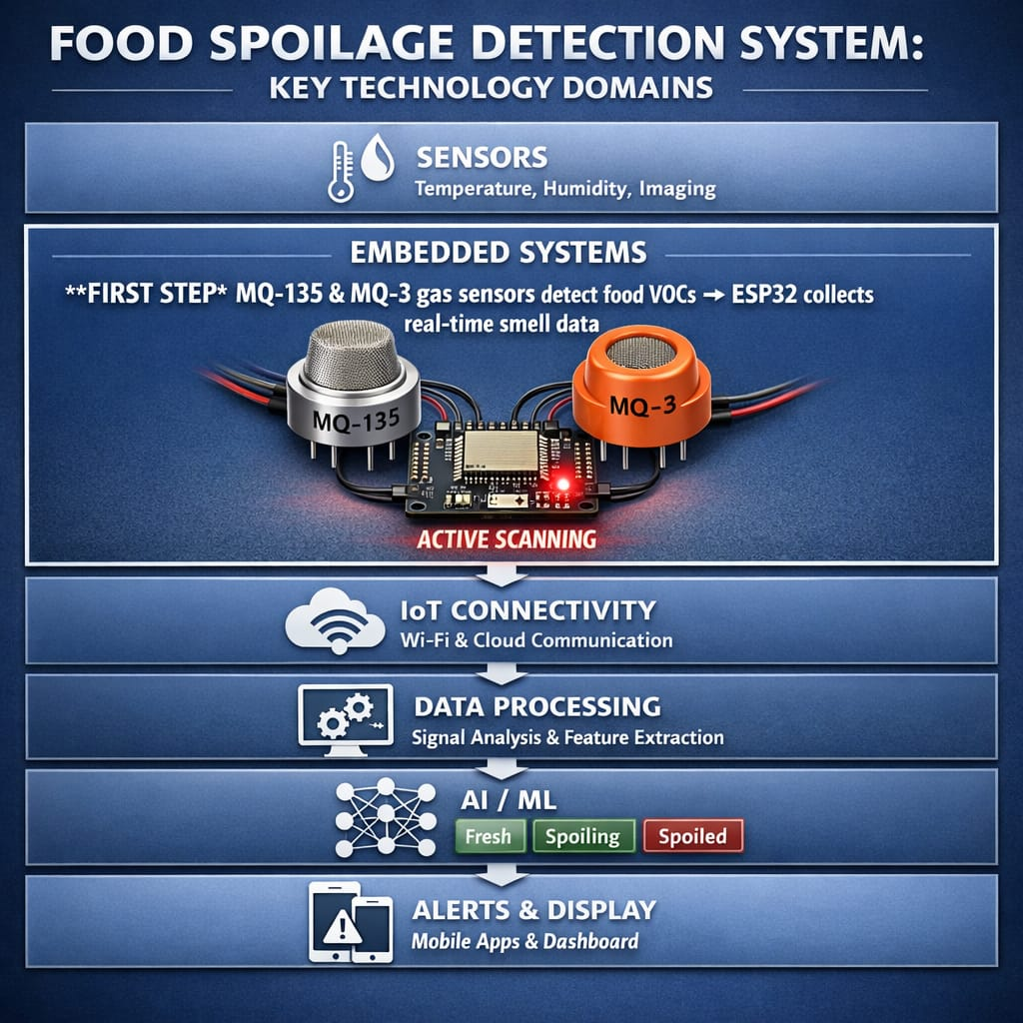
Tech Diagram, Stack & GitHub Repo Link:

